Slide 1

Understanding Major Declaration
Office of Undergraduate Advising
Notes:
Tourgee

Slide 2
Thinking about your major

Slide 3
All students in their second year who have not taken a leave of absence previously are required to declare their major during the Spring of their second year. If you already know what you want to declare then go straight to the section covering the declaration process. If you are still deciding which to pick then please continue with this one.

Slide 4

Choosing a major can be stressful but it can help to keep several key points in mind:
Major =/= job. What this means is that there is no one job that graduates from a particular major must pursue nor does not declaring a specific major mean you will never work in that field. While it is true that certain major/career combinations may be easier to match than others DKU majors are interdisciplinary in nature. Graduates from any major can go on to do many different types of things. You have lots of options to choose from and that is a good thing.

Slide 5

2. If you don’t know which major you like start with addressing the ones you don’t. No one is gifted or interested in all topics equally. If you have trouble narrowing down which fields you want to go after start by marking out those you definitely do not. For example, if you are excited by many of the classes you take in one division but always struggle or are not motivated by the ones you take in another mark out the majors with the classes that you struggle with. If you do not like something now chances are you will not like doing it everyday as part of your career.

Slide 6

3. There’s more to a major than just a title. Use the Undergraduate Bulletin (2020-2021) to explore each major, specifically the class options that you will get to explore in each. You may not realize what kinds of classes you will get to take when all you know about a major is its name. Exploring the major programs in depth might help you discover a program you never considered is actually a great fit for you.

Slide 7

4. You don’t have to decide alone. One of the great things about DKU is the community that can help you explore your options and decide among them. You have your advisor, the faculty you’ve worked with over the past few semesters, professional staff from all over the university, and even your upper classmen and friends.
That said, when asking for opinions it’s important to be careful. Just because a major is popular or a perfect fit for everyone you know does not mean it is the right fit for you. No one you talk to is going to be taking your classes for you or marketing you with your degree, you get to do that. Use their opinions to help you make your own, not to make your decision for you.

Slide 8

5. Finally, remember that no degree has inherent value – the value comes from you! A degree is only valuable if you can use it to market yourself for that job or graduate program you hope to get after graduation. When you’ve narrowed your choices down to just a few options think about each from the perspective of how you will use it to talk about yourself and your experience. Imagine you’re at an interview for your dream job or the perfect graduate program. Describe yourself to that interviewer with each of the options you are considering then think about which approach feels best to you. You may find that it is a lot easier to market yourself with one background. If so, that is a good indicator that whichever program that was may be a good fit for you.

Slide 9
The What-if Report

Slide 10
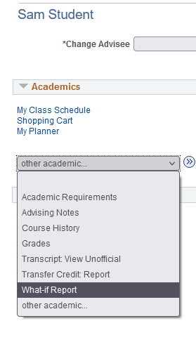
One of the very best tools for helping you learn about a particular major is located in the Student Center of DKU Hub – the What-if Report. You can view this report when you visit your Academic Advisor.

Slide 11
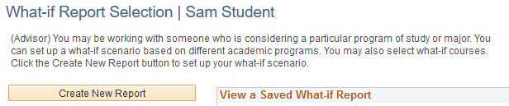
To start, your advisor can click on the What-if Report link in the Student Center then click on Create New Report on the next page.

Slide 12
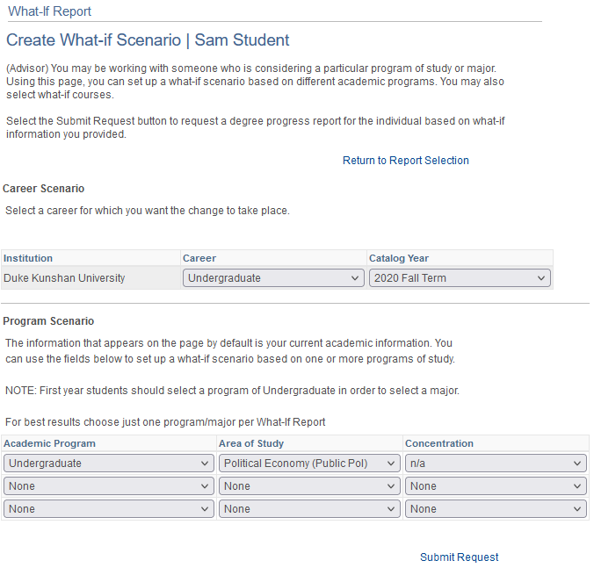
On the next page be sure to leave the Catalog Year on the term you entered, the only thing you and your advisor want to edit would be the Area of Study, there on the middle column of the bottom section. You’ll get best results by only selecting one major at a time.

Slide 13
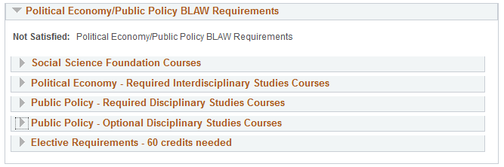
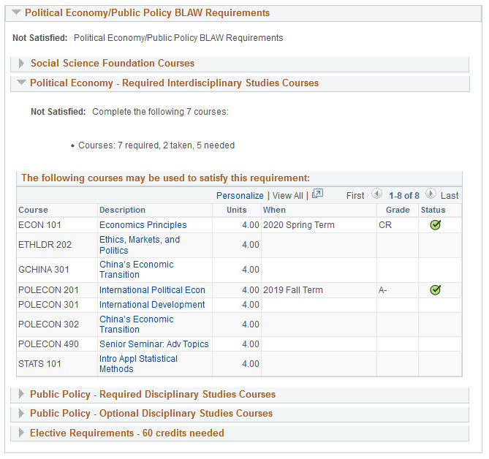
This is the report you were looking for. What this is doing is taking your classes and putting them into the degree you selected so you can see how much progress you have in that program. The top section is always the same for every major – total credits taken/needed, progress on language, core, capstone courses, etc. Where things become useful is partway down when you get to the major section.
By default sections you completed are collapsed, but you can expand or collapse sections at will by using the arrow on the left hand side of each header line. Here is the same page with one of the sections expanded.

Slide 14
What this means is that you now have a tool that can show you your real progress in any degree DKU offers. This is all of the same information found in your bulletin, just customized specifically to you. Of course, looking at a single major at a time is only one way to use this tool. You can also use them to compare between programs by opening two versions in separate windows.

Slide 15
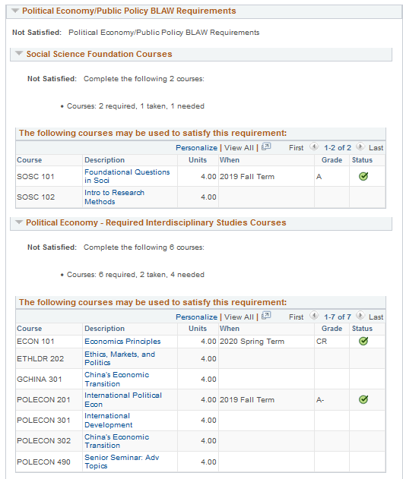
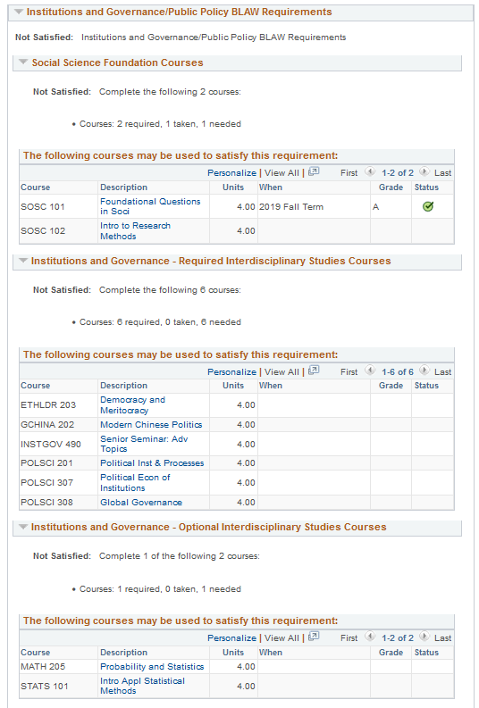
For example, if Sam knew he wanted to learn public policy but wanted to compare how it is set up between two different majors he can open both. The system doesn’t always like this so be sure not to hit the back button on the first window or else you’d have to redo it.
Besides comparing between majors you can also compare tracks within a major or click on individual courses to learn more about each of them. If you’re still trying to pick a major be sure to explore this tool with your advisor.

Slide 16
The Process

Slide 17
Major Declaration Process
1. Prepare to Declare
Consult resources: UG Advising Resource Page
Prepare materials
What-If Report
Four-Year Plan

Slide 18
Major Declaration Process
2. Advisor Meeting
Meet with advisor well before the declaration deadline
Review and approve what-if report, four-year plan
Remove Academic Advising Hold only after reviewing both documents
Students who do not declare their major will be prevented from registering for classes for their fifth undergraduate semester and from participating in a semester or study abroad program.

Slide 19
Major Declaration Process
3. Declaration
Student submits Qualtrics survey to formally declare, deadline is forthcoming but expect it in March, 2023
Office of Undergraduate Advising will share list of declared students with Division Chairs and Major Conveners. Office of the Registrar will process formal declarations and apply majors in DKUHub.

Slide 20
Major Declaration Resources
Undergraduate Bulletin
List of Majors and MOE Chinese degree names
DKU Course Planning sheet
What-if Report in DKUHub
Four-Year Plan Worksheet
Links and how-to guides are located at UG Advising Student Resources page/ Major Exploration Resources

Slide 21
Major Declaration Resources
Student Points of Contact
Academic Advisor
Major Convener, Division Chair
Office of Undergraduate Advising

Slide 22
Questions? advising@dukekunshan.edu.cn

